Slide 1
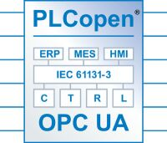
PLCopen and OPC UA a perfect match
Eelco van der Wal
Managing Director PLCopen
Notes:
1
Welcome here in the notes of this presentation
These notes provide you additional information on the subject

Slide 2

Notes:
2
PLCopen is about efficiency in automation.
And that is very much needed because we are depending more and more on automation.

Slide 3
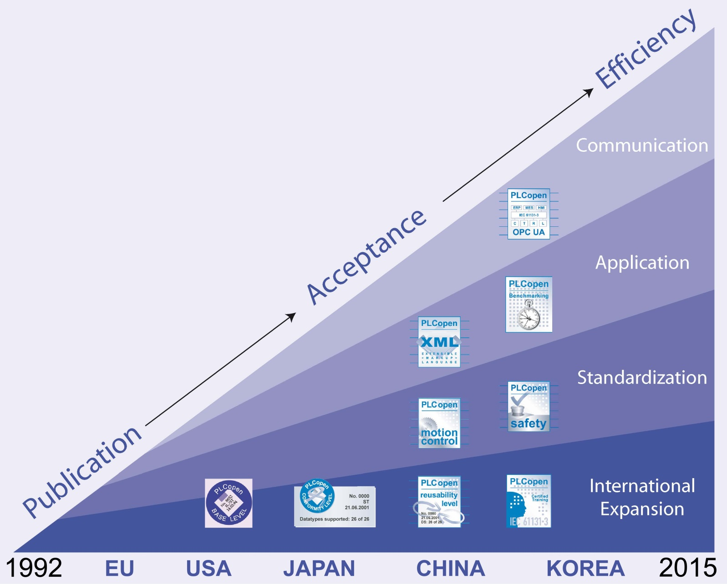
Notes:
PLCopen started in 1992 and so in now over 22 years old: a mature organization with many things going on
3

Slide 4
PLCopen as a World-wide association
Main Office in Europe
Office in Korea
Office in North America
Office in China
Office in Japan
Notes:
PLCopen is a world wide non-profit organization, which is headquartered in The Netherlands, and has supporting offices in North America, Japan, and China. Currently we are setting office in Korea. These last organizations have or will have a local website in their local language, making it easier to access the information.

Slide 5
What is this?
1100 1010 0011 0101
Notes:
The problem is: what is represented in this physical memory location?
16 bits of digital input? Or output? Or 2 characters, or an integer.
5

Slide 6
How do I get access to it?
1100 1010 0011 0101
Where can I find it?
Notes:
Ann the issue is of course – how do I get access to it.
Otherwise stated: how can I find it.
6

Slide 7
RPM =2000
HMI with graphic representation of temperature value
How ?
Controller with temperature value
Notes:
If we want a simple representation of a parametr is a controller, that can be quite complex today.
So we got to change that.
7

Slide 8
It is not about the networks
It is about communication
It is not about data
It is about information
Notes:
See slide
8

Slide 9


Communication (TC4)
Notes:
The cooperation between OPC Foundation and PLCopen using the technologies OPC UA (Unified Architecture) and IEC 61131-3
9

Slide 10
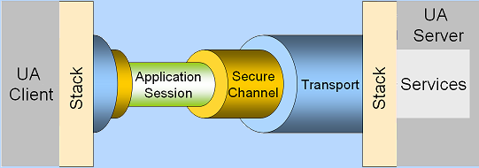
TC4 Communication
OPC UA specifies HOW
PLCopen specifies WHAT
Notes:
OPC UA specifies HOW to communicate.
For this it uses a Client-Server architecture, between which it builts an application session via a secure channel over any transport layer.
This makes it netwrok independent.
PLCopen specifies WHAT, meaning it provide the information. And it does that via names and corresponding datatypes.
10

Slide 11
IEC 61131-3 Software Model
Configuration
Resource
Resource
Variable access path
Task
Task
Task
Task
FB
Function Block
Program
Program
Program
Program
Variable
FB
FB
FB
FB
Global and direct variables
Execution control path
Access path
Communication Function
Notes:
11
The IEC 61131-3 Software Model provides the basis to link both technologies

Slide 12
Notes:
With the mapping of the OPC UA information model (here shown on the top two levels) to the IEC software model (shown on the second level with examples on the bottom level), a transparent overview can be provided, very much like your explorer on your PC. One can find and read or write all relevant parameters and names.
Communication will never be the same.
12

Slide 14
How?
Source Code
Standard
Communication to
OPC UA Client
Development Environment
Proprietary
Standard
Compiler
Controller / Run time environment
Logic Motion Safety
Program
OPC UA Server
Implementation
Shared
Information
Notes:
How is this done?
Normally you create your application program in source code in a proprietary development environment.
This source code is then compiled (or sometimes interpreted) creating an executable file for the run time environment (controller), which is also proprietary.
The for the OPC UA mapping, the compiler also generates the shared information with an overview of all the relevant data, as seen partly in the previous slide. The format of this is also proprietary. This data is linked to the OPC UA Server, which is open towards the OPC UA Client.
14

Slide 15
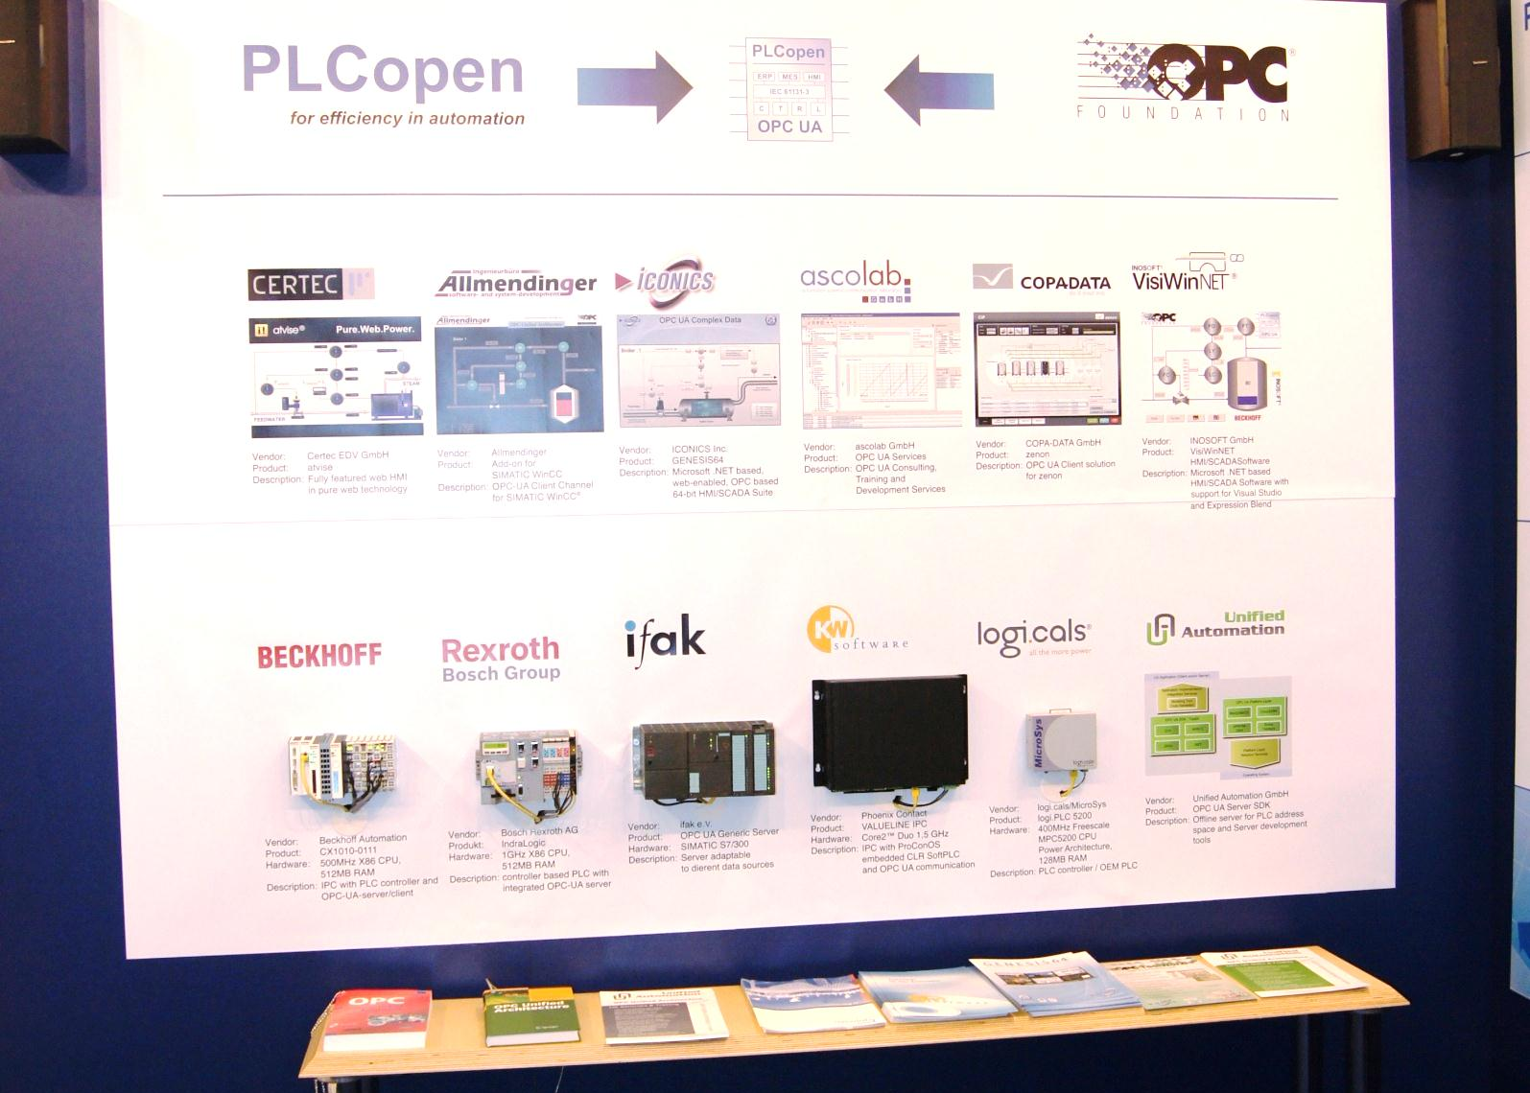
Notes:
And that this is reality was shown live at the SPS event in 2012 already with 6 different SCADA suppliers and 6 different control suppliers, all running the same program being a boiler demo and capable of presenting the data on the HMI by just change the basic IP address of the controller. The structure in the controller (the namespace) was the same since all controller ran the same program.
15

Slide 16
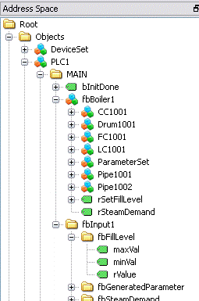
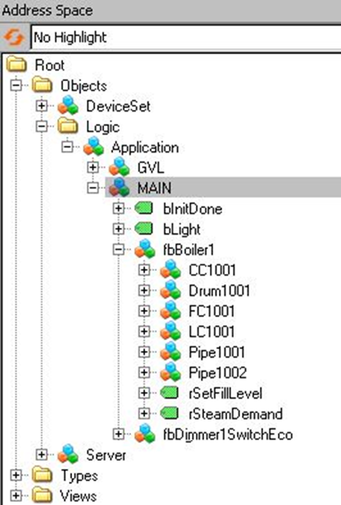
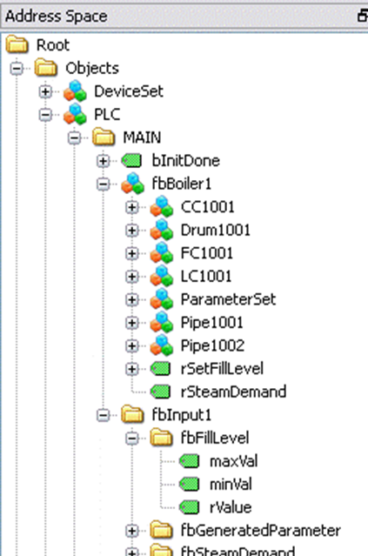
Beckhoff Cntrl Bosch-Rexroth Logic B&R Cntrl
Different entry point:
... but semantic identical objects!
Notes:
Different control suppliers have different entry points in their IEC 61131-3 environments.
However due to the PLCopen extensions, this maps to the same name spaces.
So only the IP address of the entry point has to be known to find the same structure and information.
16

Slide 17
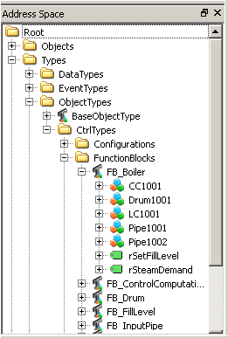
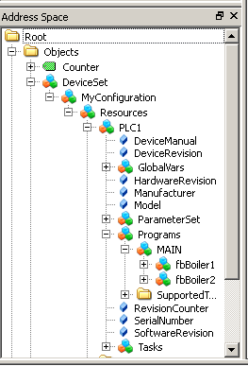
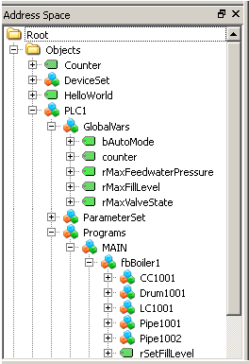
Entry point into namespace
Object types based on
Function Blocks
Full object hierarchy
below DeviceSet
Entry point for DA Clients like HMI
Notes:
Transparent view of the relevant information in several sections of the namespace, which is mapped to the IEC 61131-3 software model.
17

Slide 18
Advantages for users
Transparent Access to relevant information
  like Variables, Datatypes, Function Blocks, Structures, Tasks, etc.
Less Engineering time in overall control systems (Controller, HMI, SCADA, ERP, etc.)
Transparent Communication independent from system and network
“Communication will never be the same”
Notes:
See slide
18

Slide 19
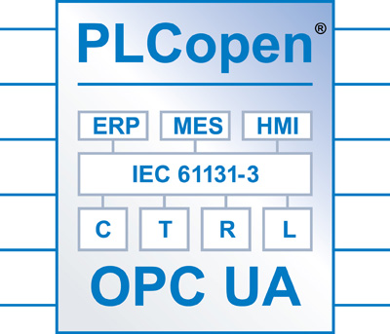
Transparent communication independent from system and network
Notes:
The cooperation between PLCopen and OPC Foundation truly brings transparent communication out of the box in to the field.
19

Slide 20
The logo
Notes:
And that is why the logo shows that OPC UA technology is used to link the controllers to higher level systems like ERP, MES and HMI within the PLCopen environment.
20

Slide 21
The cooperation
Notes:
So a successful cooperation
21

Slide 22
New activities with OPC Foundation
Notes:
But there it did not stop….
22

Slide 23
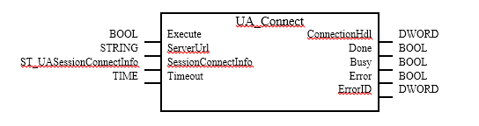
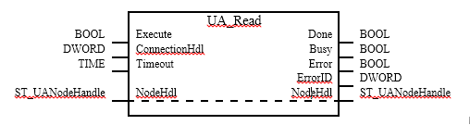
PLCopen & OPC: The logical next steps
FB‘s for Data Communication Prototype implementation
of all FB‘s done !
  UaConnect
  UaNodeGetHandle Call for Review Dec-2013
  UaNodeReleaseHandle Release March 2014
  UaNodeGetInfo
  UaMonitoredItemCreate
  UaMonitoredItemDelete
  UaRead / UaReadList
  UaWrite / UaWriteList
  UaMethodGetHandle
  UaMethodReleaseHandle
  UaMethodGetInfo
  UaMethodCall
Diagnosis
  UaConnectionGetStatus
Notes:
The next logical step was to integrate also a OPC UA Client in the controller, creating the possibility to communicate from controller to controller – or from machine to machine. Transparent and out of the box with a set of communication function blocks. And prototype implementations exists since Nov. 2013.
23

Slide 24
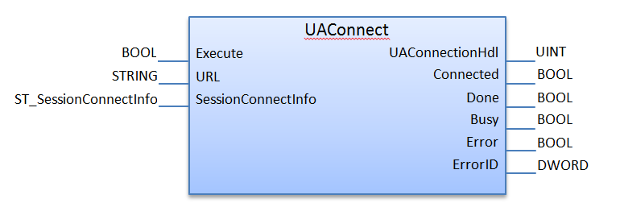
Controller-to-Controller Communication
Goal: to define a set of FBs for UA Client communication
Basis for Machine-to-Machine communication
Notes:
This FB is key for the future
24

Slide 25
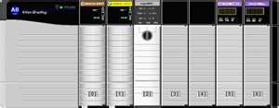
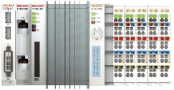




Controller-to-Controller Communication
  PLCopen & OPC-UA-FB’s:
  - Vertical communication
  - Horizontal communication
  - Fieldbus independent
  It’s fast – but not a fieldbus!
Plant Engineering
MES System
OPC UA Server
OPC UA Server
OPC-UA
OPC-UA
OPC-UA
OPC-UA
Notes:
With this the higher level communication gets transparent: horizontal and vertical, while underneath the different fieldbuses deal with their dedicated functionalities like motion control and safety.
25

Slide 26



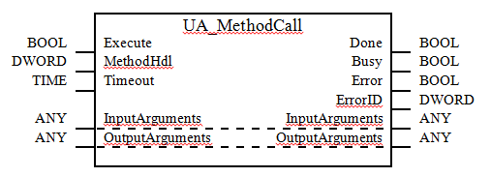



Future: Connection out of controller
MES System
Plant Engineering
OPC UA Server
OPC UA Server
Virtual machine
Database
Notes:
And then we are not even done: the next step is to do a method call from the controller towards ‘ the cloud’ . In that way the controller can initiate an method in any other system. And via a secure network. The controller is back in control.
26

Slide 27
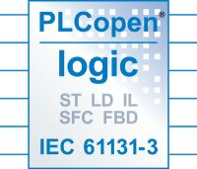


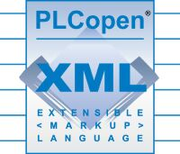

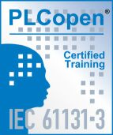

Overview PLCopen
Notes:
PLCopen does not only support OPC UA technology. PLCopen brings a suite of specifications to the market covering different areas while combining in to a total concept.
27

Slide 28
Notes:
28
And PLCopen does that, because they are focused to creating efficiency in automation.
And that is very much needed because we are depending more and more on automation.

Slide 29

Notes:
PLCopen is primarily depending on its members.
They pay an annual fee which provides the basis to operate.
And with a multitude of members the independency of the organization is guaranteed.
So think about supporting this organization and be seen as such in the market while influencing your future.
29

Slide 30
More Information... and to download the specifications (f.o.c)
www.PLCopen.org
Free-of-Charge electronic Newsletter ‘PLCopening’ (in English)
email: evdwal@PLCopen.org
Notes:
30
More information?? See above
And check the other presentations on the different subjects.

